Slide 1
Web Technology
Roshan Kr. Shah
web technology basics

Slide 2
We need to answer…
…How is the Internet organised?
…How do we find and retrieve pages on the Internet?
…How is this data (web pages, etc) transmitted over the Internet?
…How is what we see in the browser window defined as a collection of data?
web technology basics

Slide 3
Clients and Servers
The Web is a client/server application: Web browsers are clients which send requests to Web servers, which send responses back.
web technology basics

Slide 4
Fetching Pages over the Internet
Architecturally, the Internet consists of a collection of layers, each one providing services for the one above it:
  The Internet Layer gets packets to their destinations;
  The Transport Layer sends streams of data;
  The Application Layer provides high-level services to applications such as Web browsers.
web technology basics

Slide 5
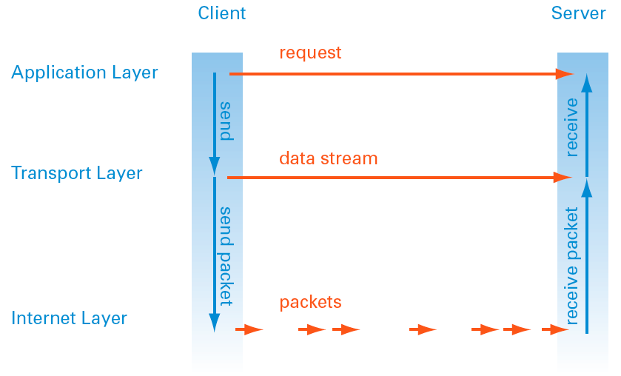
Fetching Pages over the Internet
Internet Protocol Layers
web technology basics

Slide 6
HTTP
HTTP makes use of TCP to open connections between clients and servers and to pass the requests and responses between them.
When a user clicks a link or types a web address:
  A TCP connection is opened between browser and server
  Then requests and responses are sent back and forth using HTTP
HTTP is a stateless protocol, meaning each request for data is dealt with in isolation; once the server sends the response, it forgets everything about the original request.
web technology basics

Slide 7
Fetching Pages over the Internet: HTTP
/ response
HTTP
Hypertext Transfer Protocol
TCP
Transmission Control Protocol
IP
Internet Protocol
web technology basics

Slide 8
Uniform Resource Locators (URLs)
Without a universal addressing mechanism, it would be impossible to navigate to a site, and page linking would not be feasible
Uniform Resource Locators (URLs) are used to identify Web pages — basically a URL is a web address
URLs have 3 components:
  A Prefix (usually http:// )
  A Hostname: (such as www.cityu.edu.hk)
  A Path: (such as /scm/index.htm)
web technology basics

Slide 9
Uniform Resource Locators (URLs)
Example:
http://www.cityu.edu.hk/scm/index.htm
Path
Identifies a file within a hierarchical directory structure on the server
Host name
Identifies a particular computer somewhere on the Internet
Prefix
The transfer protocol required to request data from the server
web technology basics

Slide 10
Uniform Resource Locators (URLs)
Example:
http://www.cityu.edu.hk/scm/index.htm
Path
Identifies a file within a hierarchical directory structure on the server
Host name
Identifies a particular computer somewhere on the Internet
Prefix
The transfer protocol required to request data from the server
web technology basics

Slide 11
IP Addresses and DNS
Every computer connected to the Internet must have a unique IP address, no matter whether it’s a client or a server (or both)
An IP address is just a number that identifies a host on the Internet. Example:
212.171.218.34 or 144.214.5.218
The Domain Name System (DNS) is a database that matches IP addresses to host names
web technology basics

Slide 12
Domain Names
And the Domain Name System (DNS) translates host names into IP addresses, which are then used by TCP to establish connections between HTTP clients and servers.
Domain names are administered in such a way that they are guaranteed to be unique.
Domain names are organized in a hierarchical structure….
web technology basics

Slide 13
Top Level Domains
Top Level Domain (TLD)
Mostly country domains:
.uk, .au, .hk, etc.
www.cityu.edu.hk
www.cityu.hk
www.apple.com
Generic Top Level Domain (gTLD)
.com
.org
.net
.biz
.info
.name
.ws
.tv
(.edu, .gov, .mil restricted to US only)
web technology basics

Slide 14
Second Level Domains
www.cityu.edu.hk
www.cityu.hk
www.apple.com
The actual name of the organisation or service.
Can contain letters
(a to z),
numbers (0 to 9),
dashes ( - )
web technology basics

Slide 15
Third Level, or Sub Domains
www.cityu.edu.hk
sweb.cityu.edu.hk
www.apple.com
store.apple.com
seminars.apple.com
Strings of characters that designate different services, or hosts within the second level domain.
E.G. “www” for the core or main website, “sweb” for SCM’s sub-network within CityU.
web technology basics

Slide 16
Registering Domain Names
Registered with the HKDNR in Hong Kong
www.hkdnr.hk
www.cityu.edu.hk
www.cityu.hk
www.apple.com
Registered with any global registration service
networksolutions.com
register.com
directNIC.com
etc.
Chinese character domain names now also available
web technology basics

Slide 17
Registering Domain Names
Registering a domain name can either be done directly with a registration service, such as HKDNR, or through a website hosting service.
Either way, you have to pay a fee for domain registration that is separate from any site hosting fees you may pay.
  gTLD domains (.com, .org, .net): US$12 - 15 per year
  Country domains in Hong Kong:
  .com.hk, .org.hk, .net.hk: HK$200 per year
  .hk: HK$250 per year
web technology basics

Slide 18
Linking Domain Names and IP Addresses
A domain name, once registered, needs to be associated with a fixed IP address of a web server on the Internet. When you register and setup a new domain name, you need to enter details of at least 2 nameservers.
  These nameservers are special internet servers that implement a name service protocol.
  They may be provided by a web hosting service, or a domain registration service.
  They link a domain name to the specific IP address assigned for a website. Examples:
ns0.directnic.com
ns1.directnic.com
Note: Most commercial hosting services provide a form of virtual hosting, placing many websites on a single server, so special software is used to route domains names to assigned IP address.
web technology basics

Slide 19
Domain Names… not just websites
Once your domain name is assigned a specific IP host you can:
Set up and run a website (www.cityu.edu.hk)
Set up e-mail accounts (nick.foxall@cityu.edu.hk)
Set up file transfer capabilties (ftp.cityu.edu.hk)
web technology basics

Slide 20
Paths
http://www.cityu.edu.hk/scm/index.htm
Path
Identifies a file within a hierarchical directory structure on the server
Host name
Identifies a particular computer somewhere on the Internet
Prefix
The transfer protocol required to request data from the server
web technology basics

Slide 21
Paths and Pathnames
A pathname shows the hierarchical directory structure and location of a specific file or resource on a server.
A directory is represented visually these days as a folder
web technology basics

Slide 22
Absolute and Relative Paths
An absolute path is a path that points to the same location on one file system. It is usually written in reference to a root directory.
The root directory is the first or topmost directory in a hierarchy, indicated with a single slash / or backslash \ .
Example:
C:\Documents and Settings\mnfoxall\My Documents\My Files
web technology basics

Slide 23
Absolute and Relative Paths
A relative path is a path relative to the current working directory, so the full absolute path may not need to be shown or referred to.
This works for creating websites, because it allows hypertext links to be made between files relative to a pre-defined working directory.
That is, they do not have to always reference the root directory or topmost directory on a server (or computer).
web technology basics

Slide 24
Absolute Paths
C
Example: to hyperlink from index.htm to products.htm
If an absolute pathname:
<a href=“C:\\Users\My%20Documents\Websites\Company\products.htm”>
web technology basics

Slide 25
Relative Paths
C
Example: to hyperlink from index.htm to products.htm
If a relative pathname, with /Company defined as the working or site root directory
root
<a href=“products.htm”>
web technology basics

Slide 26
Relative Paths
To hyperlink from
index.htm to logo.jpg
root
<a href=“images/logo.jpg”>
web technology basics

Slide 27
Relative Paths
To hyperlink from
shoes.htm to index.htm
(i.e. back up one level in the directory hierarchy)
root
2 dots and a slash
<a href=“../index.htm”>
web technology basics

Slide 28
Relative Paths for Websites
In website development, it’s much easier to use relative paths.
A site developed locally on one computer (under an assigned site root directory or folder), is much easier to transfer and manage on the final web server using relative paths.
  In Dreamweaver, the first thing to do is set up a new site using the ‘Site Definition’ interface. This way, a local ‘site root’ folder can be created to gather and manage all files related to the site.
web technology basics

Slide 29
Home Page Naming
For…
http://www.cityu.edu.hk
…there must be a default HTML page that is displaying as the home page. In the case of CityU, it is…
http://www.cityu.edu.hk/index.html
…meaning index.html is the default HTML page in the root directory of the server.
web technology basics

Slide 30
Home Page Naming
Web servers will automatically serve up pages file-named
index.html
index.htm
default.htm
default.html
…as long as ONE page by those filenames resides in the root directory of your site.
If you want to use a page by another name as the home page of the site, you will have to configure the server software to point to that page.
web technology basics

Slide 31
Web Page Naming (HTML naming Conventions)
All lower-case, no spaces, no special characters [other than dash ( - ) or underscore ( _ ) ].
products.html
Products.html
products_sept07.html
products sept/07.html
The same applies to the name of folders and sub-folders within your site.
 recommended
 ok, but not recommended (esp. in XHTML)
 recommended
 not recommended
web technology basics

Slide 32
Server Software
Just connecting a computer to the Internet and giving it an IP address does not make it a web server. Server computers have to run special web server software to open TCP connections and respond to HTTP requests.
The two most common web server applications are:
Apache (UNIX-based, open source) 50%*
IIS - Internet Information Services (Microsoft) 36%*
* Percent of all websites served on the Internet: Sept, 2007
web technology basics

Slide 33
Summary: URLs, HTTP, domains, paths
Uniform Resource Locator (URL)
The common addressing mechanism used to navigate the web
http://www.cityu.edu.hk/scm/index.htm
Host name,
domain name
Identifies a particular computer or server somewhere on the Internet.
The Domain Name System translates Internet Protocol (IP) addresses into unique recognisable names that have to be registered with assigned domain registration services.
Second- or sub-level domains can identify different servers or services within the same domain.
Path, pathname
Identifies a file within a hierarchical directory structure on the server.
Paths can be Absolute (that is, hierarchical from the top of the file system or volume), or Relative (that is, hierarchical from the top of a designated working directory / root directory).
Relative paths are much preferred for creating and managing groups of web pages and resources within a site.
Prefix
The transfer protocol at the application layer: Hypertext Transfer Protocol (HTTP) is used to request web pages and related data from a server
web technology basics

